Slide 1

Final Project
Topic : Router pricing prediction and evaluation
Leung Tung Chun, Andy
21/10/2023

Slide 2


Background
Currently working in a retailer company
mainly selling routers, switches, access points, etc
interested in studying router pricing and it’s features

Slide 3
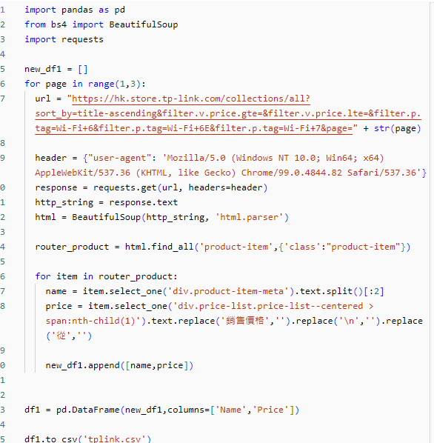
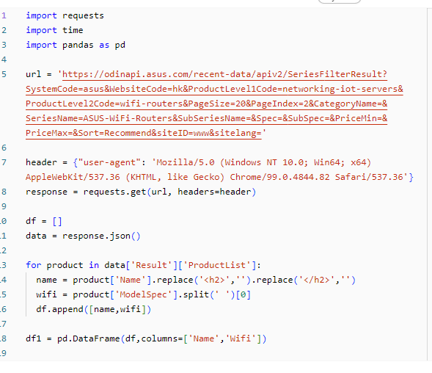
Preparation
Web scrapping
1. https://www.asus.com/hk/networking-iot-servers/wifi-routers/asus-wifi-routers/filter?Series=ASUS-WiFi-Routers
2. https://www.tp-link.com/zh-hk/home-networking/wifi-router/
3. https://www.price.com.hk/category.php?c=100047&brand=ASUS
Beautifulsoup
Databricks

Slide 4
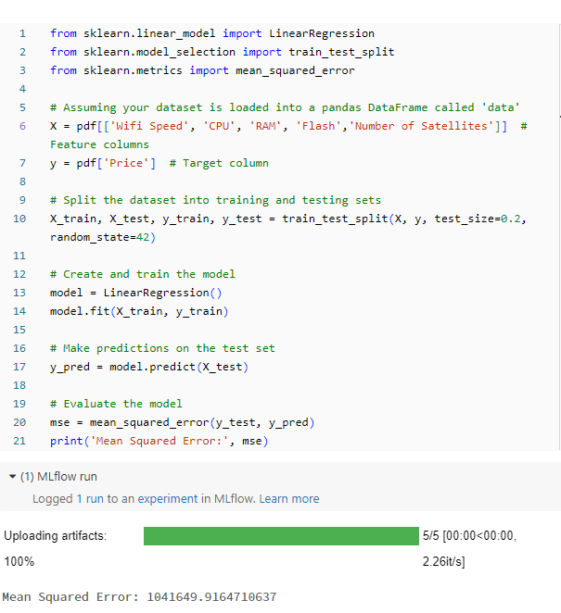
Machine Learning
Linear Regression
Scikit learn linear regression model
feature enginnering

Slide 5
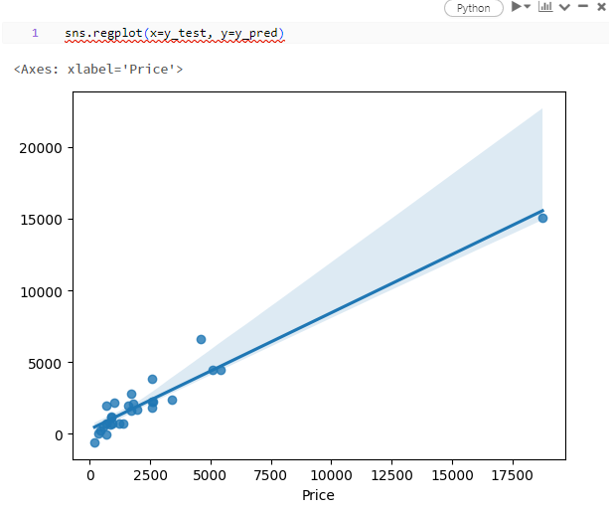
Result
The result of linear regression is the predicted prices for the given features
Mean Squared Error(MSE)
measured average squared difference between predicted vs actual prices
R2 score : 0.9116745860405348

Slide 6
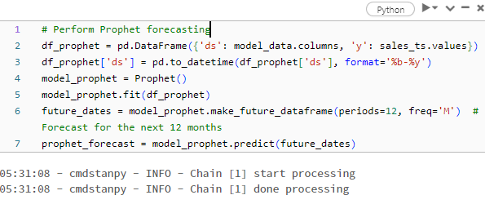
Time Series Modeling
Predict the trend of router pricing throughout Netgear
Prophet forecasting

Slide 7
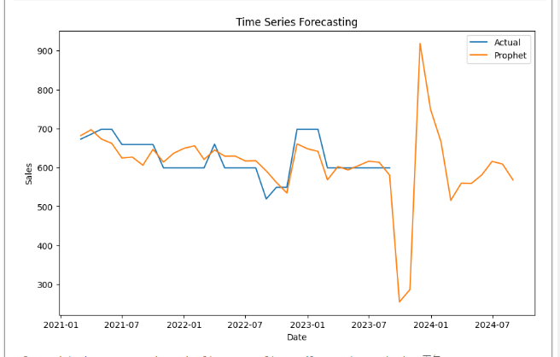
Result

Slide 8

Difficulties
Web Scarpping
Data Processing
Choice of time series modeling
Regression model

Slide 9
THE END!!!

